Slide 1
Results of the Chamber HR Committee Survey on Potential Salary Review in 2018

Slide 2
QUESTIONS
3. If your company plans to increase salaries, please specify when
January – February 2017
March – April 2017
May – June 2017
July– August 2017
September– October 2017
November– December 2017
4. If your company plans to increase salaries, please specify in percent
Up to 5%
6-10%
13-15%
Your answer
5. Did your company review salaries in 2017?
Yes
No
Comments
6. If your company increased salaries in 2017, please specify when
January – February 2017
March – April 2017
May – June 2017
July– August 2017
September– October 2017
November– December 2017
Please identify sphere of your company
Agriculture
Banking & Financial Services
Consulting and Business Services
Consumer Goods
Energy
Food & Beverage
Healthcare
IT
Infrastructure
Manufacturing
Mobile Telecom
Legal Services
Seeds
Trade
Other
2. Does your company plan salary review in 2018?
Yes, salaries will be reviewed and increased
No, there will be no salary review and increase in 2018
To be decided

Slide 3
QUESTIONS
7. If your company increased salaries in 2017, please specify in percent
Up to 5%
6-10%
11-12%
13-15%
15-20%
Your answer
8. What is your opinion regarding increase of the minimum salary rate in question?
We support improving the social standards in Ukraine
This is a positive development, but it will bring further financial burden on companies
This is a necessary step, despite the significant changes in the conditions of doing business in Ukraine
Increasing the minimum salary rate will not affect significantly the social standards in Ukraine, but will complicate financial situation of the companies
Your opinion/comments
9. Does your company plan any changes in salaries' rates due to the increase of the minimum salary rate?
Yes, according to the updated legislation, for those employees, who are receiving (or received) minimum salary
Yes, but only for certain categories of employees
No changes planned
To be decided
Your opinion/comments
10. What risks will be caused by increase of the minimum salary rate for the business, in your opinion?
Financial risks
There are no risks
Your opinion/comments
11. Do you consider indexation of salaries provided in the Ukrainian legislation as an effective instrument?
Yes, it is a necessary procedure, that is being implemented regularly
No, this tool is outdated and needs to be modernized
Your opinion

Slide 4
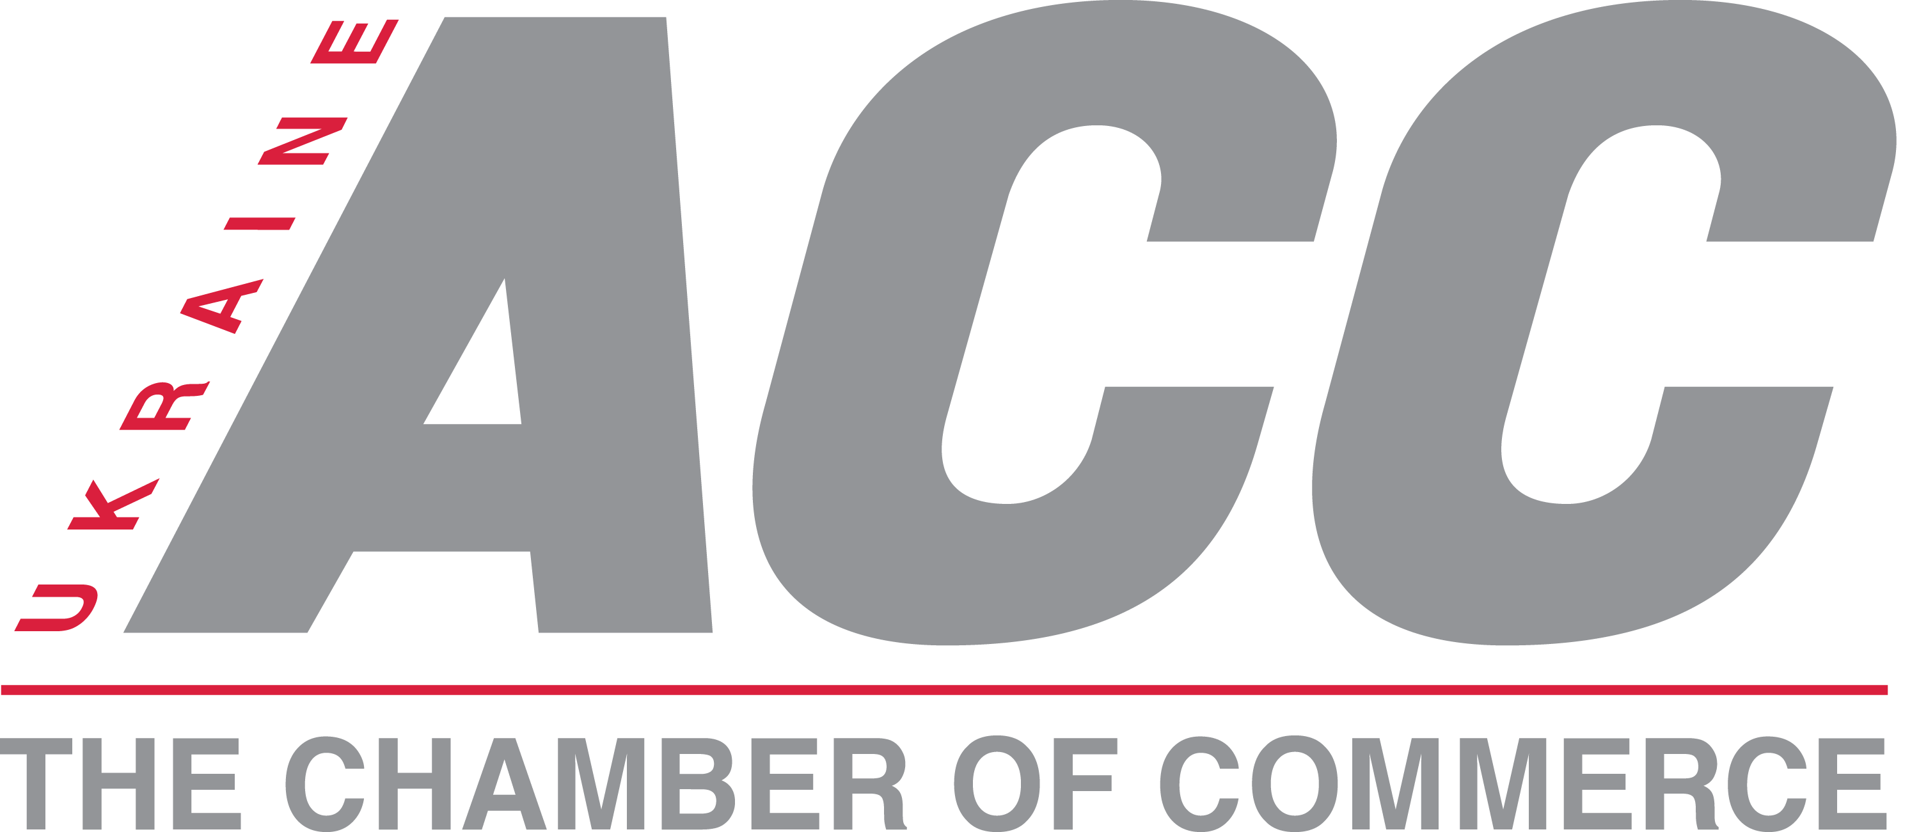
SURVEY PARTICIPANTS

Slide 5
Does your company plan
salary review in 2018?
NO YES

Slide 6
If your company plans to increase salaries in 2018, please specify when

Slide 7
If your company plans to increase salaries, please specify in percent

Slide 8
Did your company review salaries in 2017?
NO YES

Slide 9
If your company increased salaries
in 2017, please specify when

Slide 10
If your company increased salaries
in 2017, please specify in percent

Slide 11
What is your opinion regarding increase of the minimum salary rate in question?
We support improving
the social standards in Ukraine
64%
This is a positive development, but it will bring further financial burden on companies
12%
This is a necessary step, despite the significant changes in the conditions of doing business in Ukraine
12%
Increasing the minimum salary rate will not affect significantly the social standards in Ukraine, but will complicate financial situation of the companies
12%

Slide 12
Does your company plan any changes in salaries' rates due to the increase of the minimum salary rate?
Yes, according to the updated legislation, for those employees, who are receiving (or received) minimum salary
52%
6%
Yes, but only for certain categories of employees
36%
No changes planned
Your opinion/comments
6%
*There is no employees working on minimum salary

Slide 13
What risks will be caused by increase of the minimum salary rate for the business, in your opinion?
Financial risks
42%
58%
There are no risks

Slide 14
Do you consider indexation of salaries provided in the Ukrainian legislation as an effective instrument?
Yes, it is a necessary procedure,
that is being implemented regularly
36%
No, this tool is outdated and
needs to be modernized
64%

